Slide 1




ARMULTIVERSE
AR APPLICATION FOR CONSTRUCTION ENGINEERS

Slide 2
DEVELOPMENT TEAM
MENTOR
Mrs.S.ARTHY
Assistant Professor in CSE
RAJAMANI.R.M.R | 921020104028
SANGILI MUTHU.S | 921020104045
PRAVEEN KUMAR.M | 921020104036
VIDHYASAGAR.S | 921020104058

Slide 3
Abstract
This AR application enables users to view 3D models of a building under construction in real-time, providing a more accurate and intuitive representation of the structure.
The application is developed in Unity game engine, which offers powerful tools for building interactive and immersive AR experiences.
The AR application enhances the traditional methods of viewing 3D models and blueprints, providing a more interactive way to visualize a building before it is constructed.
This project can benefit architects, engineers, contractors, and building owners, providing them with a powerful tool to visualize and communicate design ideas more effectively.

Slide 4
LITRATURE SURVEYS ON AUGMENTED REALITY
SURVEY PAPER NAME | AUTHOR NAME | PUBLISHED YEAR
A Survey of Augmented Reality Applications for Construction and Building Inspection | L Cheng and J. Kim. | 2018
Augmented Reality Technology in Construction Engineering Education | W. Yu and H. Kim | 2018
A Review of Augmented Reality in the Architecture, Engineering and Construction Industry | by P. Belloni, L. Campos, and G. DeJong. | 2018

Slide 5
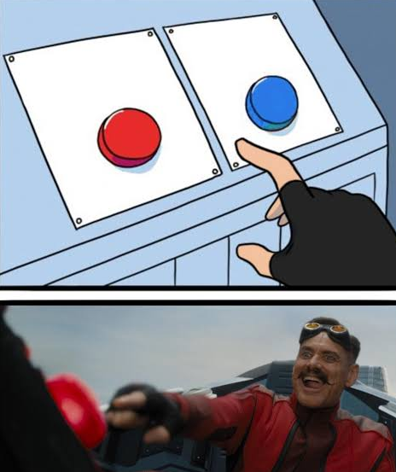
EXISTING SYSTEM
2D Blueprint
3D VIEWER
AR APP FOR ENGINEERS
2D BLUEPRINTS AND 3D VIEWERS

Slide 6
EXISTING SYSTEM
The existing system for viewing 3D models of buildings under construction typically involves the use of 2D blueprints and 3D model viewers. These methods require a certain level of technical expertise to interpret and visualize the building design accurately.
On the other hand, 3D model viewers offer a more visual and immersive experience than 2D blueprints, but they still lack the interactivity and flexibility needed to view the building design in real-time and from different perspectives..

Slide 7
PROPOSED SYSTEM
Immersive experience: The AR application offers an immersive experience that allow users to view the 3D model of the building in a more natural and intuitive way.
Real-time visualization: The AR application provides real-time visualization of the 3D model, allowing stakeholders to make decisions and communicate design changes quickly and efficiently.
Interactivity and flexibility: The AR application offers interactivity and flexibility, allowing users to view the 3D model of the building from different perspectives and angles.

Slide 8
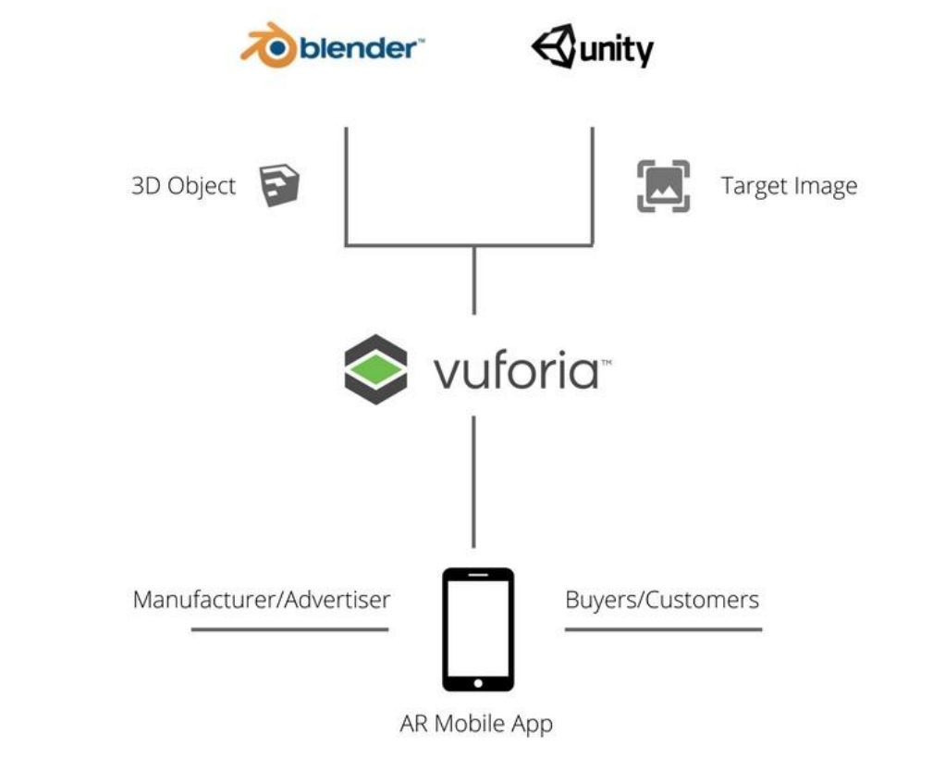
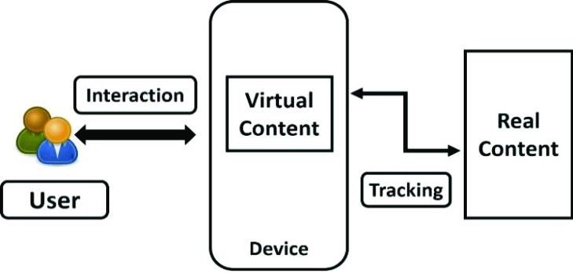
SYSTEM ARCHITECTURE

Slide 9
MODULES & DESCRIPTION
1. User Interface Module: This module provides a user-friendly interface for accessing the AR application features such as viewing the 3D model of the building, taking measurements, and adding annotations.
2. Tracking Module: The tracking module is responsible for tracking the user's movement and positioning the virtual objects accordingly. It uses sensors such as accelerometers, gyroscopes, and compasses to detect the user's movements and position.
3. Rendering Module: This module is responsible for rendering the 3D model of the building onto the user's real-world view. It uses computer graphics techniques such as texturing, lighting, and shading to create a realistic and immersive experience.
4. Cloud Storage Module: The cloud storage module is responsible for storing and retrieving the 3D model of the building from a cloud-based server. This ensures that the latest version of the building design is always available to users and can be easily shared between stakeholders.

Slide 10
CONCLUSION
In conclusion, the proposed augmented reality (AR) application for viewing 3D models of buildings under construction offers a significant improvement over existing methods of visualizing building blueprints and 3D models. By leveraging AR technology, users can view and interact with a virtual model of the building overlaid onto the real-world view, providing a more immersive and intuitive understanding of the building design.
Overall, the proposed AR application has the potential to significantly improve the design and construction process for buildings by providing a more intuitive and interactive way of visualizing building design.

Slide 11

THANK YOU
A PRSENTAION BY RAJAMANI

